Slide 1
Visual Studio Code, RPG, and IBM i

Slide 2
Index
Introduction Of VS Code
Basic features and its structure module
Keyboard shortcuts
Some IBM Code Extension
IBMi Languages
IBM Z Open Editor
Other Extensions – RPG , IBM git client , IBM Cloud
How to install Extensions and Some other tips
Demo*
User Interface, Some shortcuts
IBM I
My Extension

Slide 3
Introduction on VS Code
Visual Studio Code is a source-code editor made by Microsoft for Windows, Linux and macOS.
Features include support for debugging, syntax highlighting, intelligent code completion, snippets, code refactoring, and embedded Git.
Core feature :-
Edit, build, and debug with ease
Make it your own
Robust and extensible architecture
June 2021 (version 1.58)

Slide 4
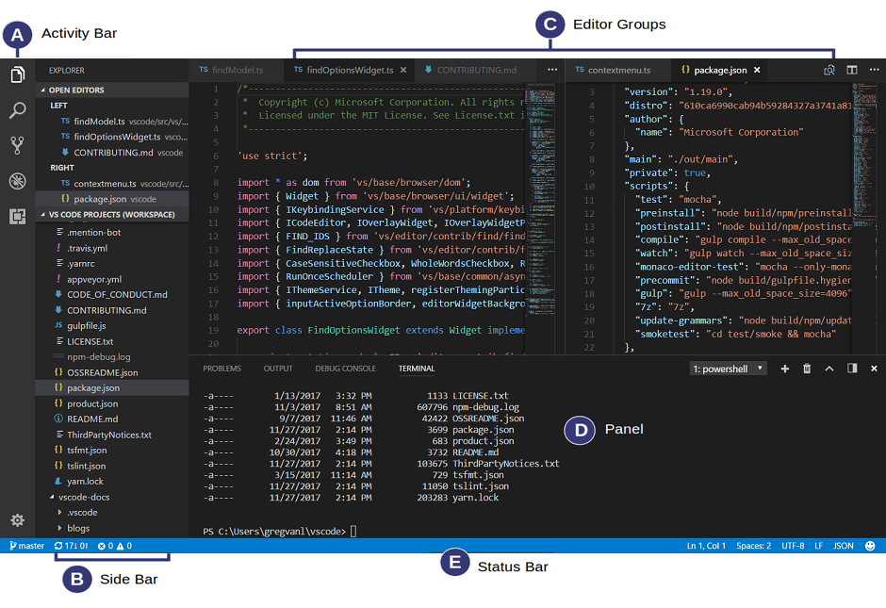
User Interface

Slide 5
Keyboard Shortcuts
General
Basic editing
Navigation
Search and replace
Multi cursor and selection
Rich lang editing
Editor management
File management
Display
Debug
Integrated terminal
Resource:- https://code.visualstudio.com/shortcuts/keyboard-shortcuts-windows.pdf
Abraham Lincoln
“Give me six hours to chop down a tree and I will spend the first four sharpening the axe.”

Slide 6
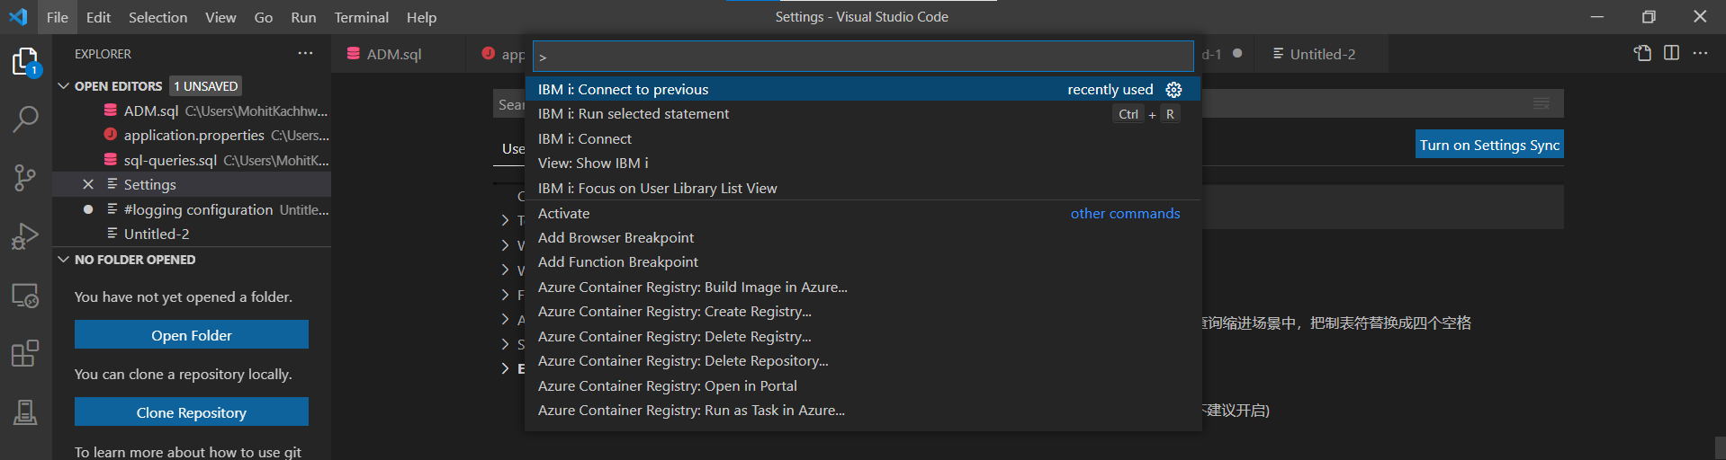
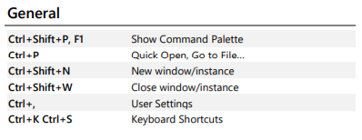
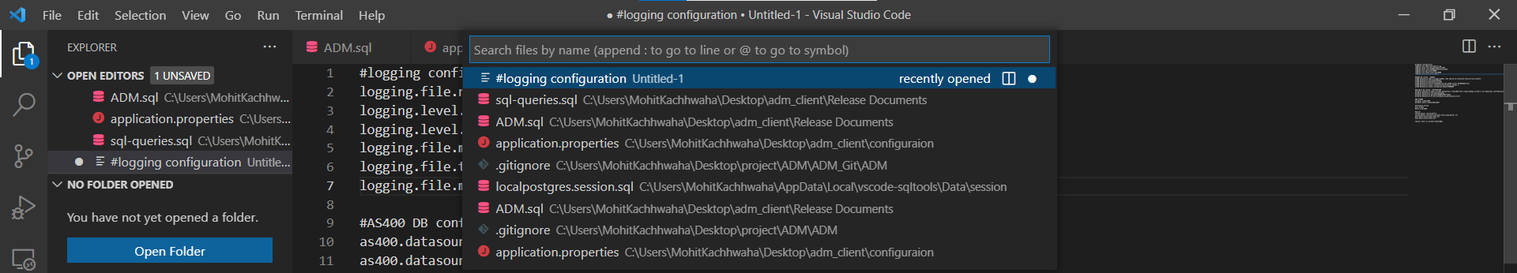
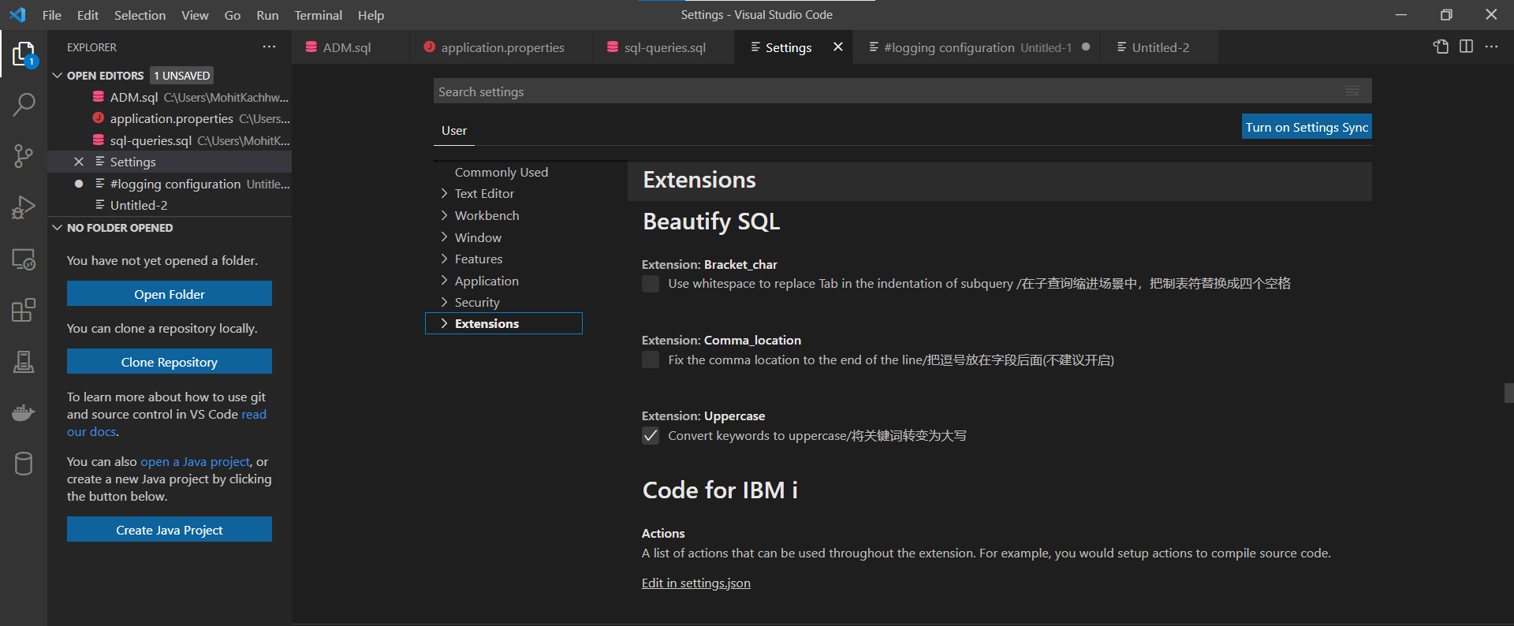
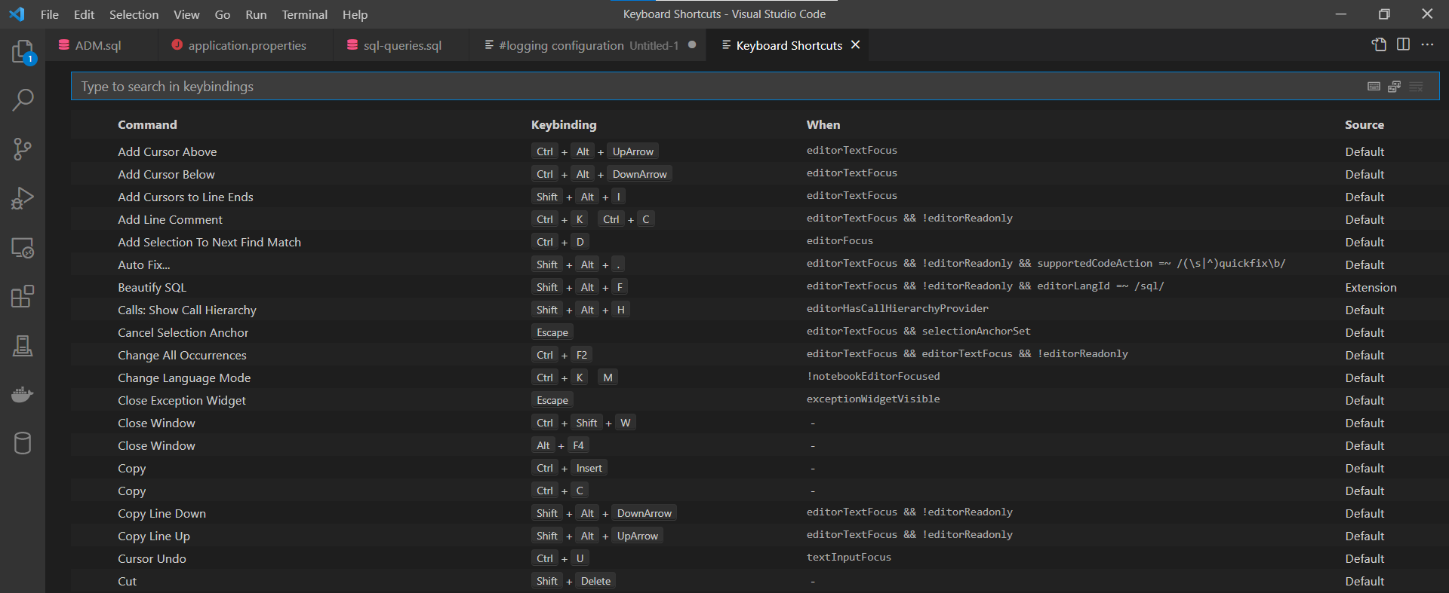

Slide 7
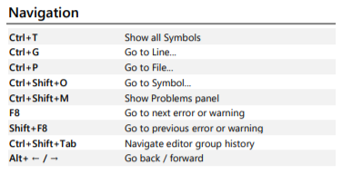
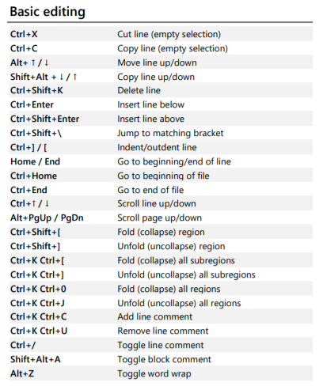
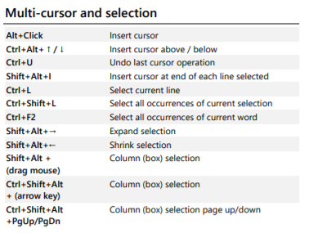
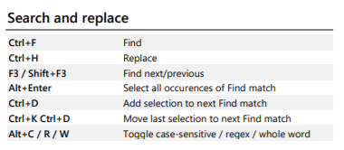

Slide 8
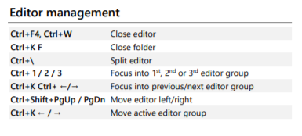
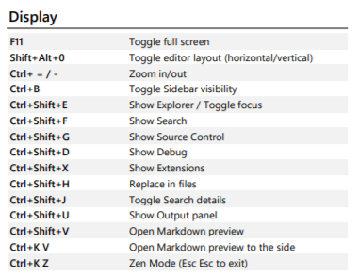
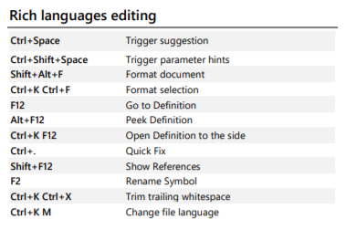
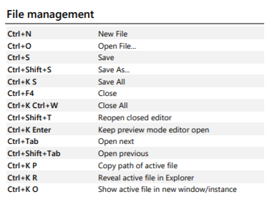

Slide 9
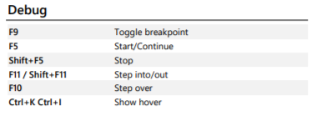
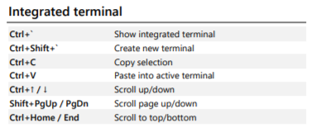
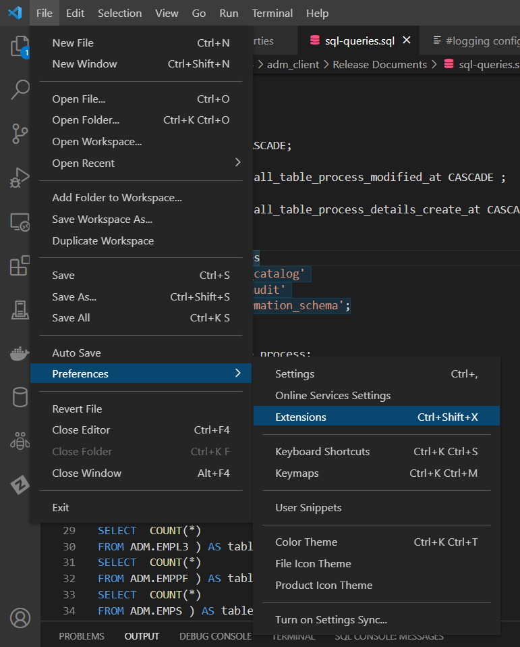
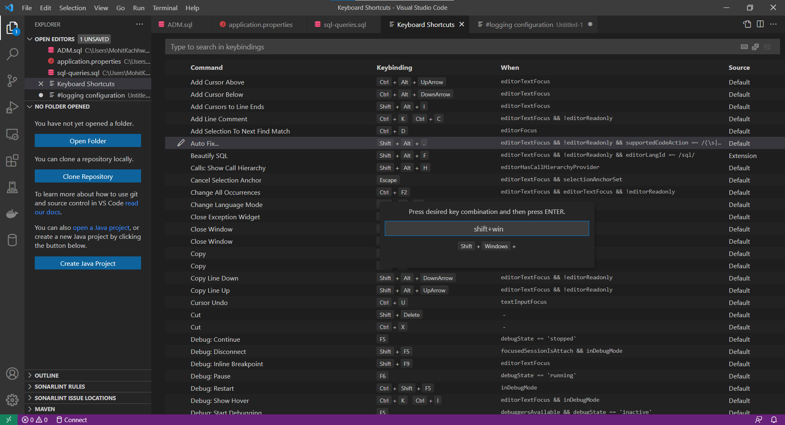

Slide 10
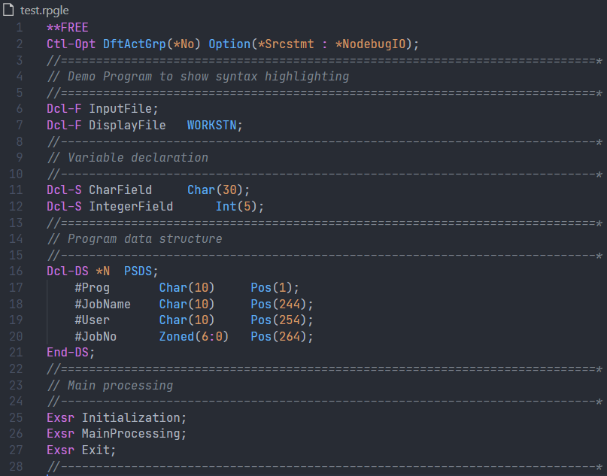
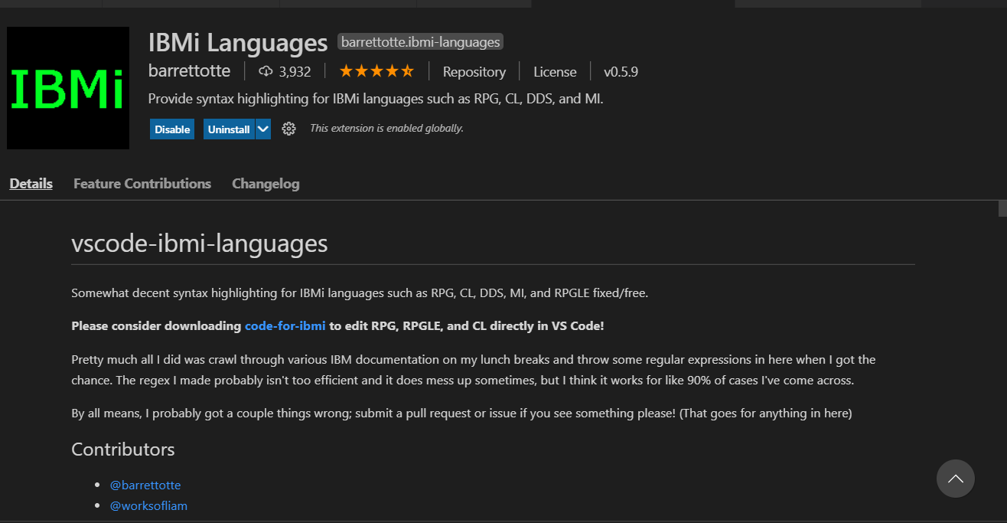
IBM i Languages by barrettotte
extension for the majority of native languages like RPG, CL, DDS, and RPGLE fixed/free. This extension provides syntax highlighting, keyword prompting, etc.
This is for RPGLE Free.

Slide 11
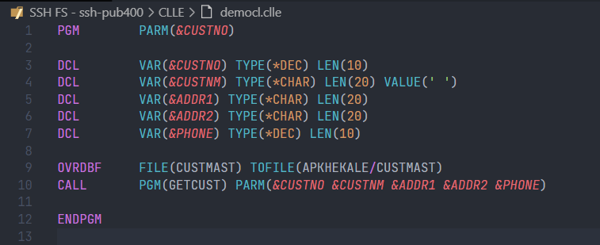
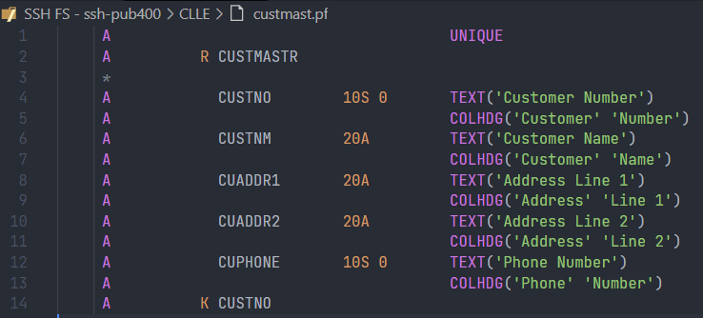
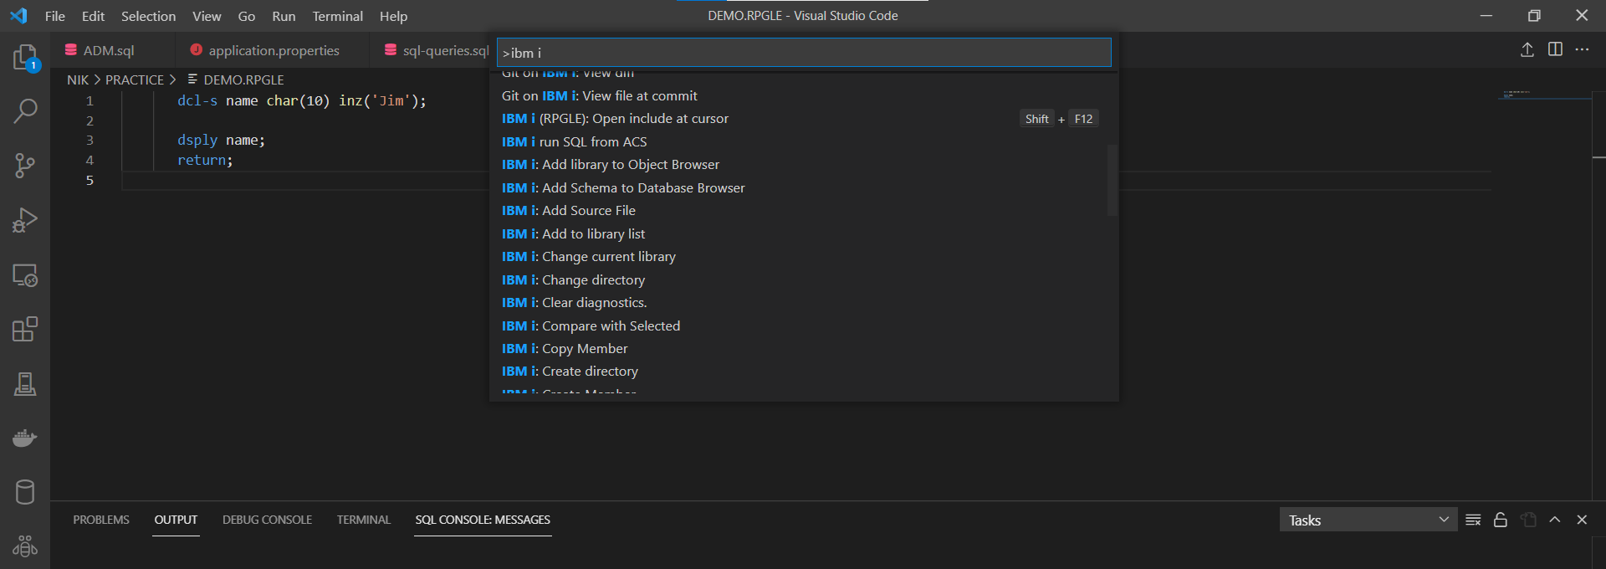
And one for DDS.
This is for CLLE.
IBM I : Commands

Slide 12
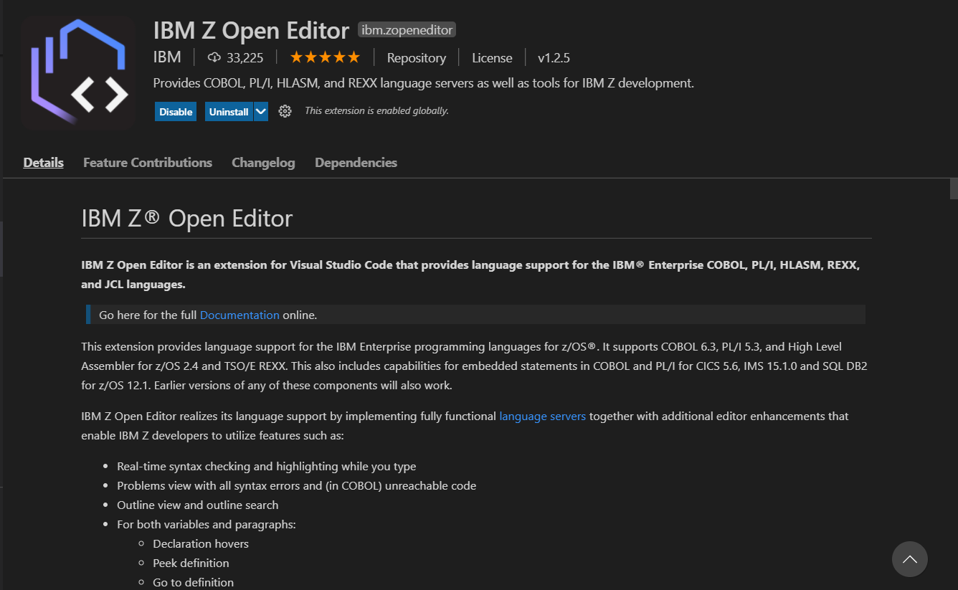
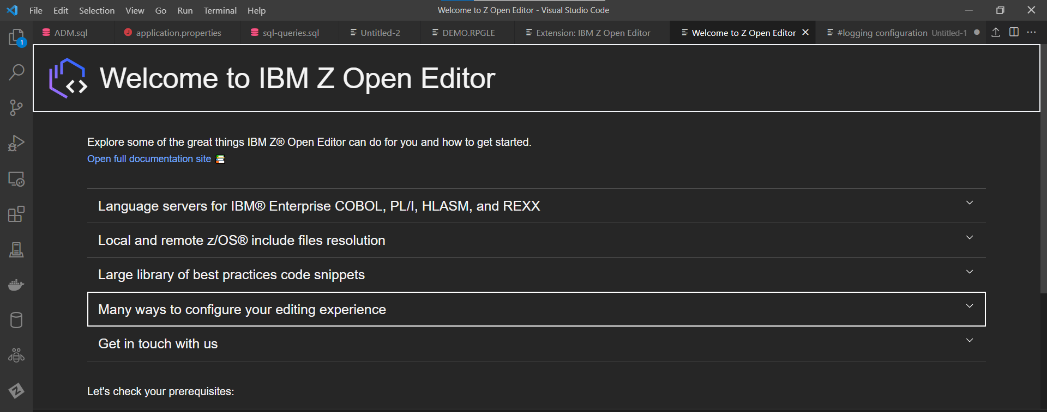
2) IBM Z Open Editor
This COBOL extension is so powerful, with few keystrokes, most of your program gets generated. Let’s see, when I start typing IDENT and hit Enter, the entire IDENTIFICATION DIVISION gets generated using the snippets provided by the extension.

Slide 13
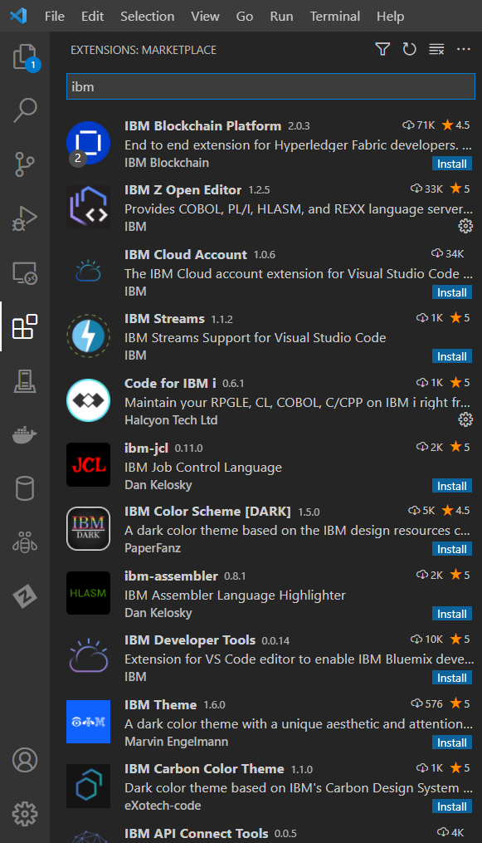
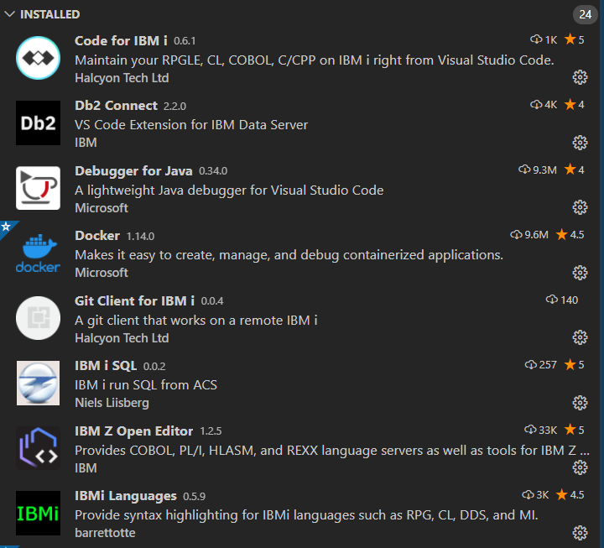
Other Extensions

Slide 14
Extensions/ Themes for Open-source Languages
Extension | Description
Bracket Pair Colorizer | A customizable extension for colorizing matching brackets - Link.
Code Spell Checker | Spelling checker for source code - Link.
Indenticator | Highlights your current indent depth - Link.
One Dark Pro Theme | Atom’s iconic One Dark theme for Visual Studio Code - Link.
Python | Linting, Debugging (multi-threaded, remote), Intellisense, Jupyter Notebooks, code formatting - Link.
SSH FS | File system provider using SSH. - Link.
Visual Studio IntelliCode | AI-assisted development. - Link.
vscode-icons | Icons for Visual Studio Code. - Link.

Slide 15

How to install Extensions & some other Tips
Click on the extension symbol as displayed by the image, type the desired extension in the search bar, when the extension appears, click on the install button, and you are done. More information here.
How to write code directly in IFS on IBM i?
It becomes convenient if we don’t have to upload the code often to the IFS directory on IBM i manually. One extension always comes in handy that is SSH-FS, which makes the IFS folder available to us in the VS Code.
SSH-FS needs the below details, along with the name of the connection.
The IP/Domain name of your IBM i system
SSH Port (generally port 22, PUB400 has 2222 port configured for SSH)
User Id
Password
Root folder (/home/USERID)

Slide 16
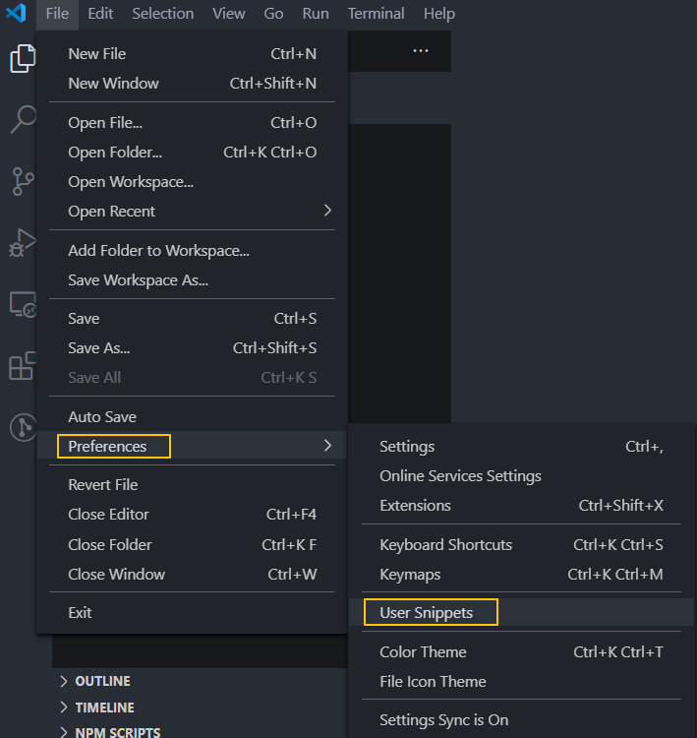
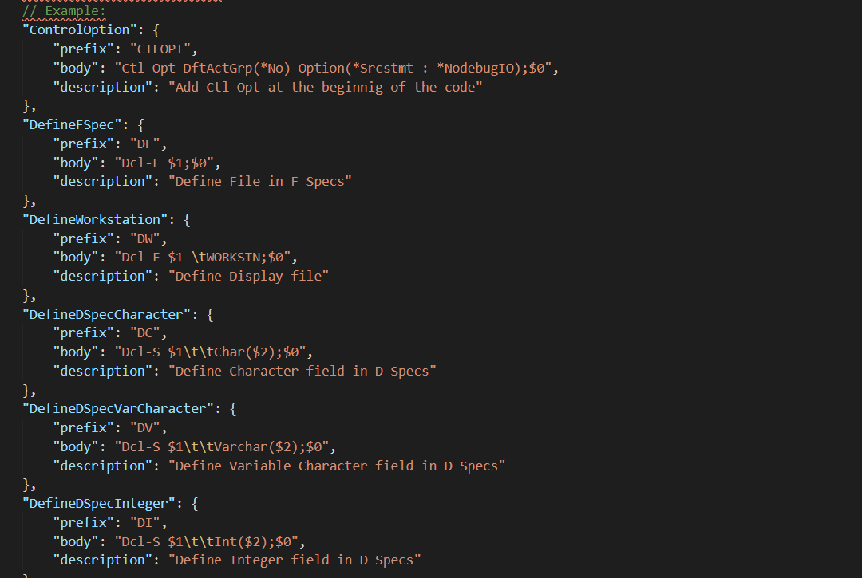
Use of Snippet
What are Snippets?
VS Code has this feature called Snippets, where we can assign a shortcut to a block of code that we write quite often. We can create our snippet for the language we want to use. We must create a file in JSON format in
File → Preferences →User Snippets.

Slide 17
Thank You

